Slide 1
Performance for JAS and ASO 2023, current status and outlook for DJFM 2023/ 2024 rainy season
PERFORMANCE AND PRESPECTIVES OVER WEST AFRICA AND THE SAHEL
FOURTHEENTH AFRICAN CONTINENTAL CLIMATE OUTLOOK FORUM (ACCOF-14)
November, 23th 2023
8:00 GMT
Presented on behalf of AGRHYMET RCC-WAS
By
Dr TINNI HALIDOU Seydou

Slide 2
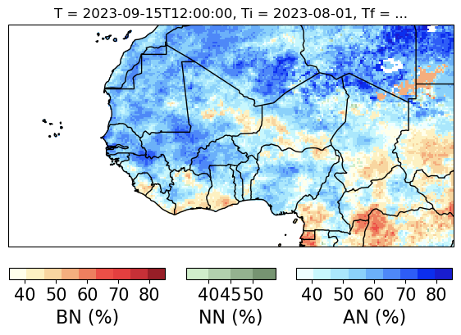
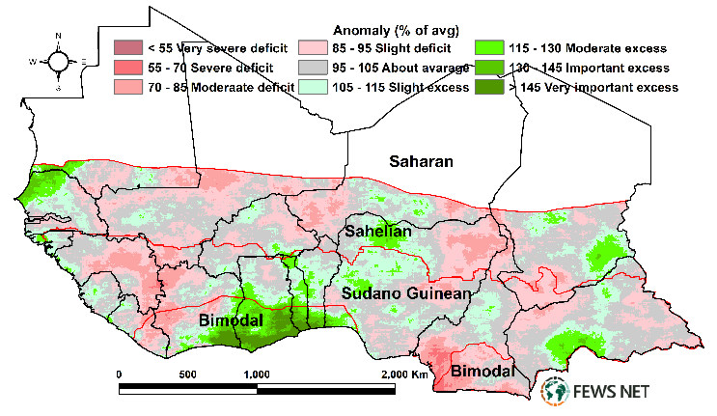
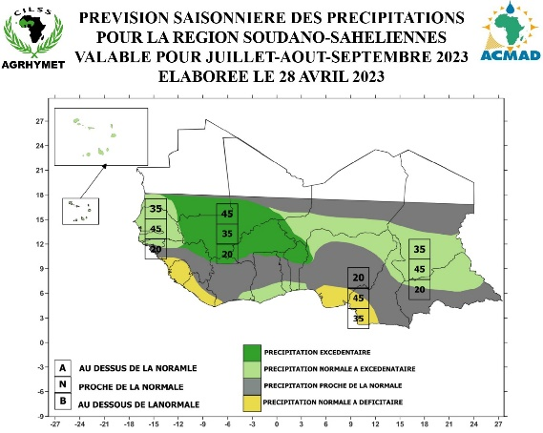
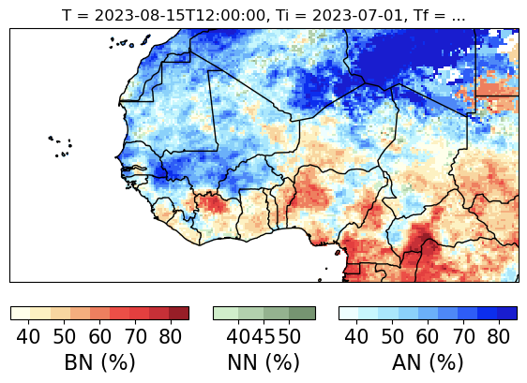
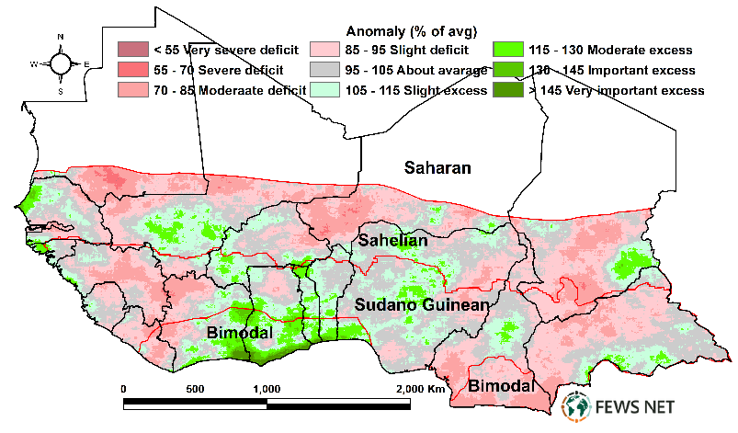
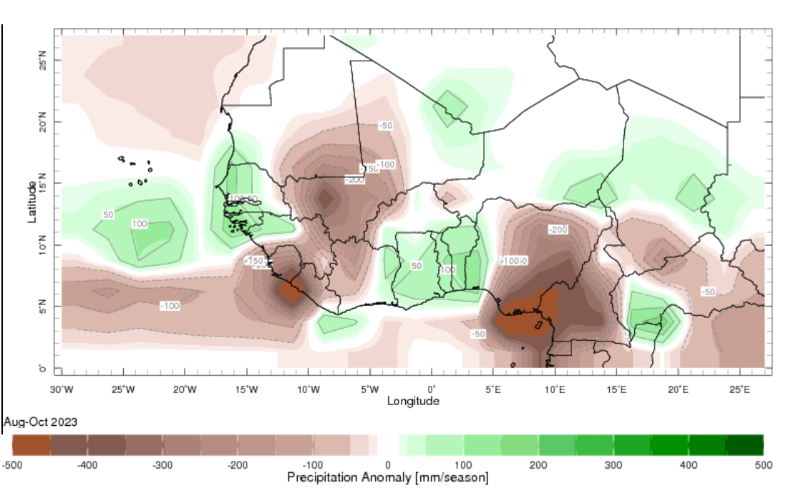
Verification of JAS and ASO 2023 season
JAS 2023
Over most of Mali, northern CI, western BF, southern Guinea, most of Nigeria it was forecasted above normal rainfall but it was observed below
Over Southern CI and Ghana it was predicted deficit but I above was observed
Deficit was expected over most of GG countries but it was observed normal to above over southern CI to southern Nigeria
Over the eastern Sahel (SE Niger and central Tchad it was observed normal to slightly above rainfall rather than bellow
ASO 2023

Slide 3
Analysis of the current Status
In October 2023, The monthly ENSO indicate well above El Nino threshold in the central-eastern equatorial Pacific Ocean (with NINO3.4 index at +1.59 °C),
During the week centered on 08 Nov, the SST anomalies in the NINO3.4 region was +1.80 °C
The Indian Ocean Dipole (IOD) warming event persists (+1.55 °C) for the week ending November 5
The North Atlantic Ocean warming exhibited persistent
Over the Gulf of Guinea, a slightly warm SST was observed
Forecasts indicate that the warming in the North Atlantic Ocean and the positive Indian Ocean Dipole are expected to persist into Dec-Feb 2024

Slide 4
Climate outlook for DJFM 2023/2024
DJF
DJF: From southern Liberia to southern Ghana is expected to have deficit of rainfall
JFM
JFM:
Sierra Leone is expected to have bellow average rainfall
southern Togo to southern Nigeria it is expected to have above normal rainfall

Slide 5
Summary
For JAS 2023 seasons:
Over most of Mali, northern CI, western BF, southern Guinea, most of Nigeria it was forecasted above normal rainfall but it was observed below
Over Southern CI and Ghana it was predicted deficit but above was observed
For ASO 2023 seasons:
Deficit was expected over most of GG countries but it was observed normal to above over southern CI to southern Nigeria
Over the eastern Sahel (SE Niger and central Tchad it was observed normal to slightly above rainfall rather than bellow
DJF 2023: From southern Liberia to southern Ghana is expected to have deficit of rainfall
JFM 2023: Over Sierra Leone is expected to have bellow average rainfall, while from southern Togo to southern Nigeria it is expected to have above normal rainfall

