Slide 1
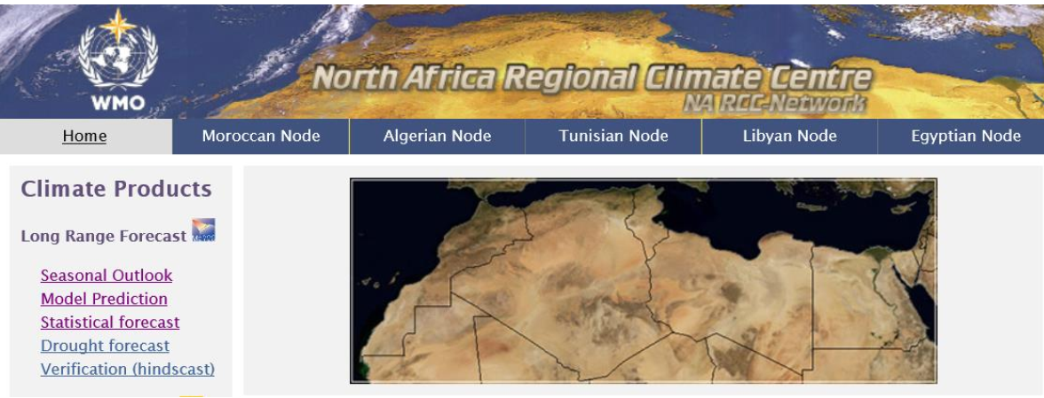
Direction Générale de la Météorologie
MOROCCO
SEASONAL FORECAST FOR DJF-2023/24
NORTH AFRICAN RCC
ACCOF14, 23 November 2023
Bouchra SADIKI (DGM,Morocco)

Slide 2
Current status of Climate

Slide 3
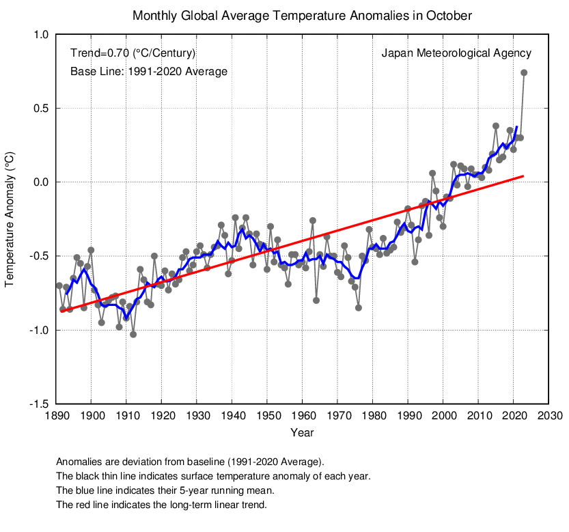
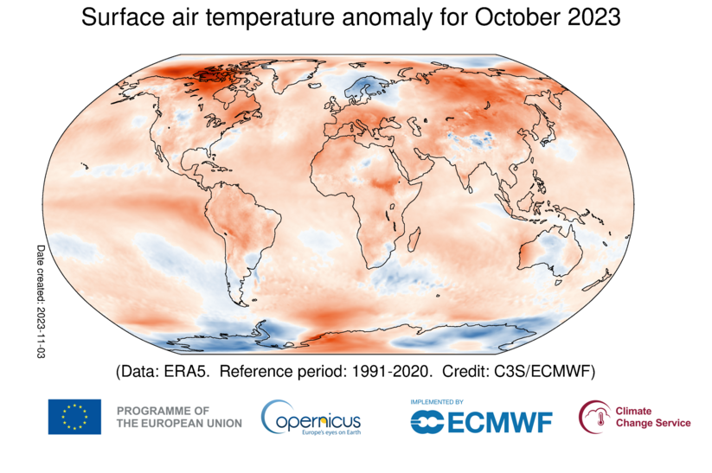
Temperature in October2023
Monthly anomaly of the global average surface temperature in October 2023 was +0.74°C above the 1991-2020 average :the warmest since 1891.

Slide 4
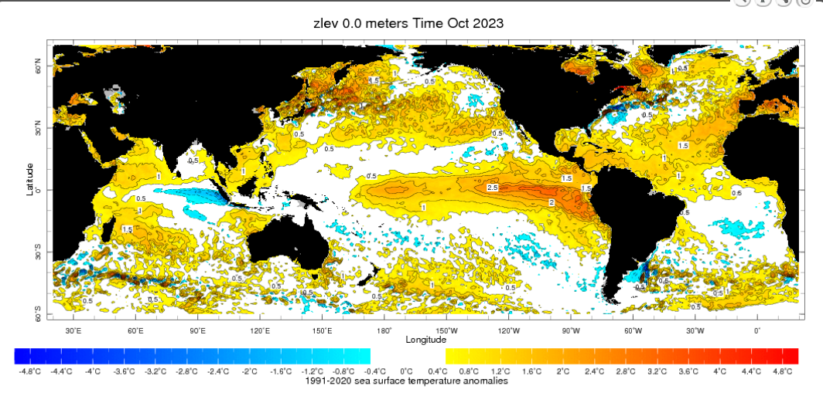
SST Anomaly October 2023

Slide 5
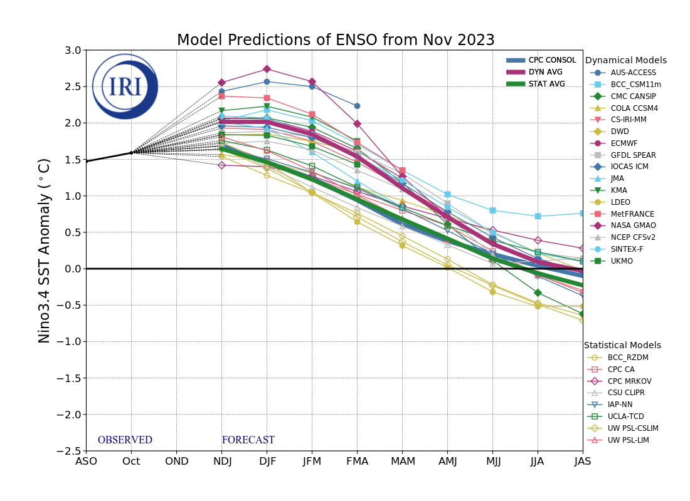
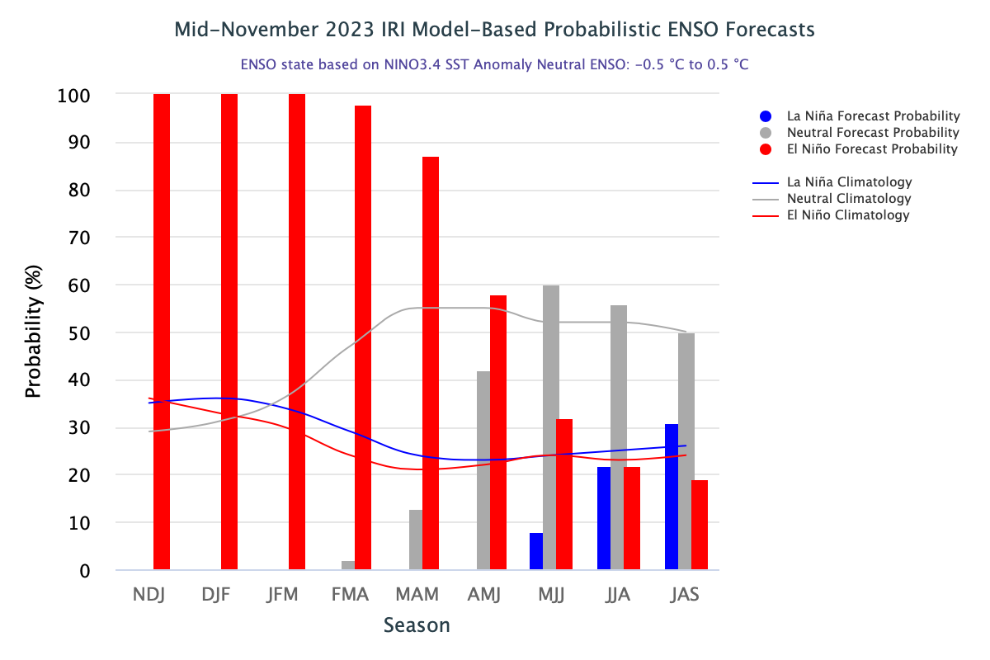
Pacific sources (ENSO):

Slide 6
Dynamical forecast

Slide 7
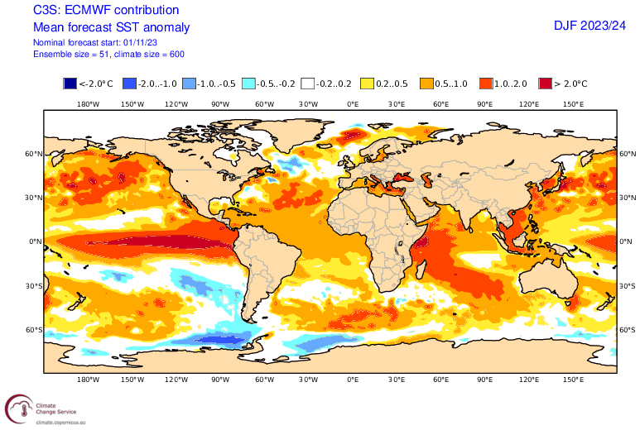
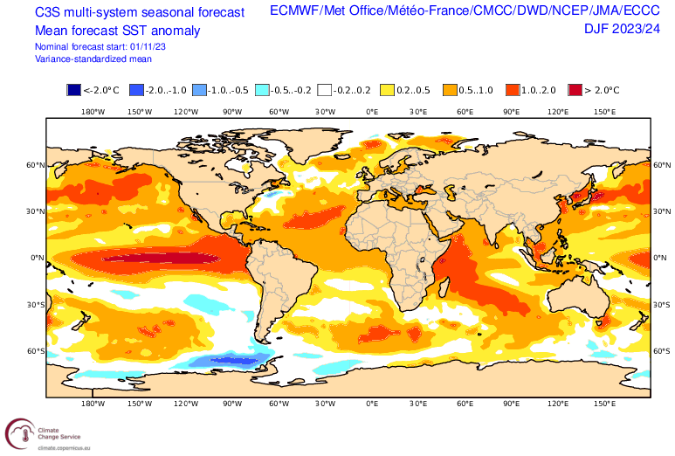
Sea Surface Temperature (SST)

Slide 8
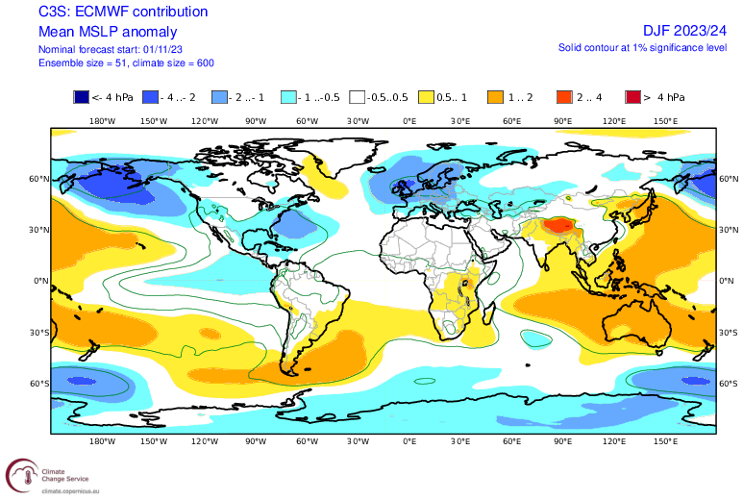
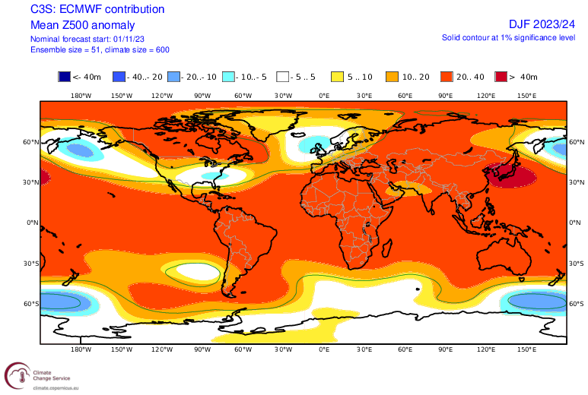
Dynamical Circulation (Z500&MSLP)
Z500
MSLP

Slide 9
PRECIPITATIONS

Slide 10
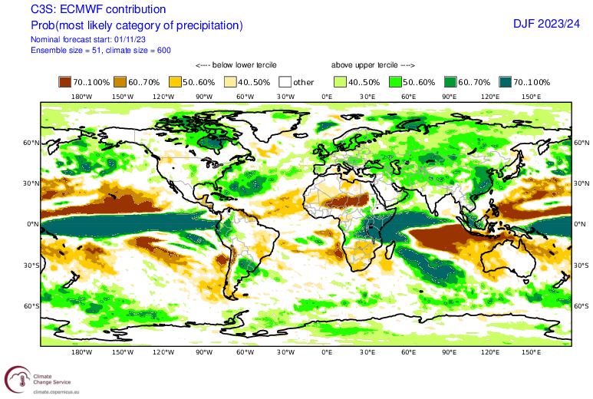
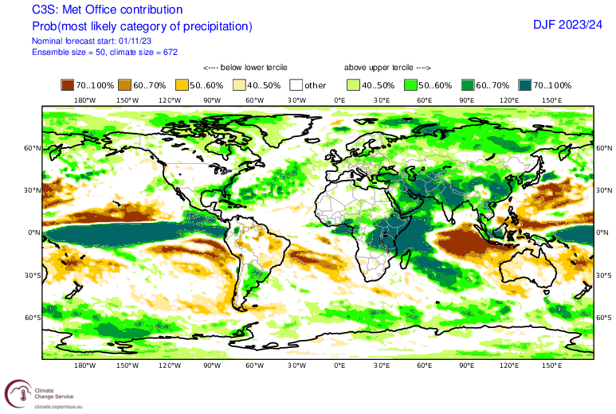
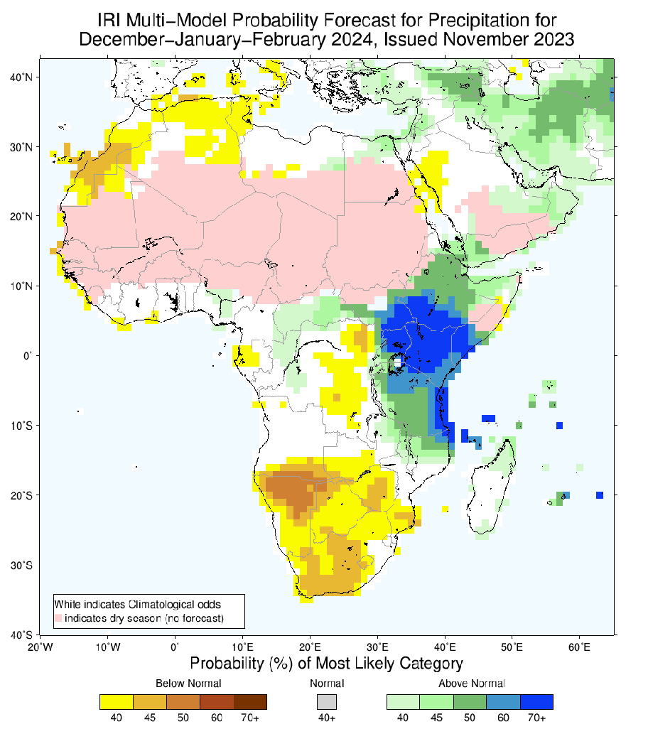
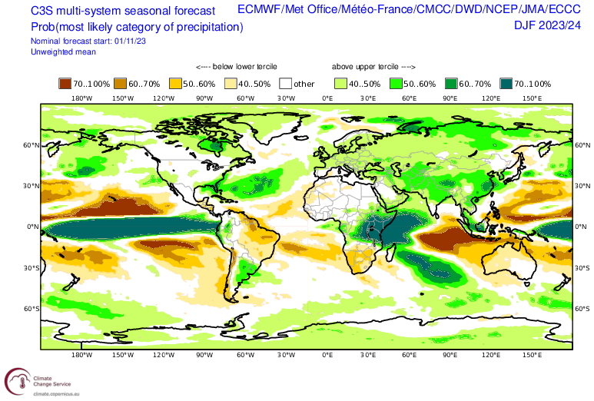
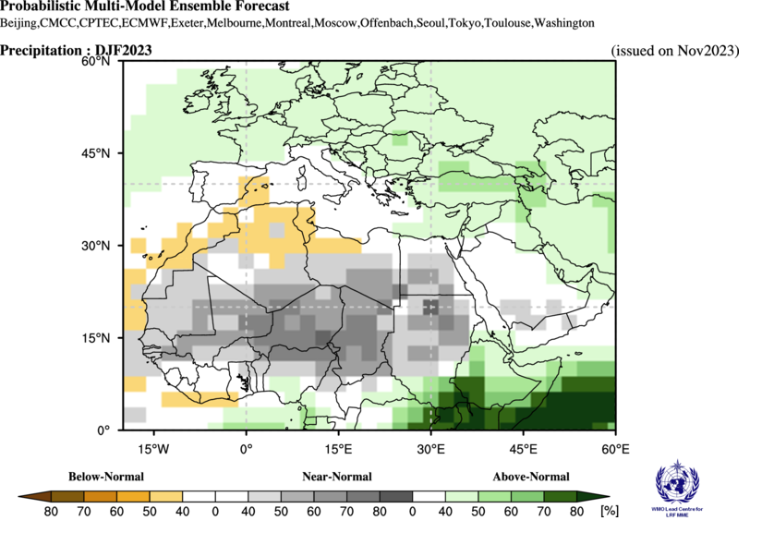
ECMWF
Met Office
IRI
C3S
WMO-LRF MME

Slide 11
TEMPERATURE

Slide 12
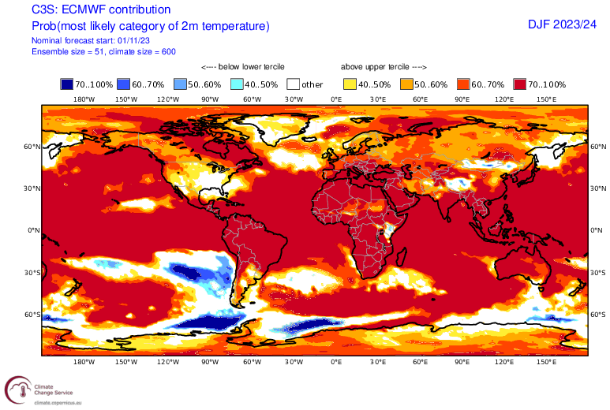
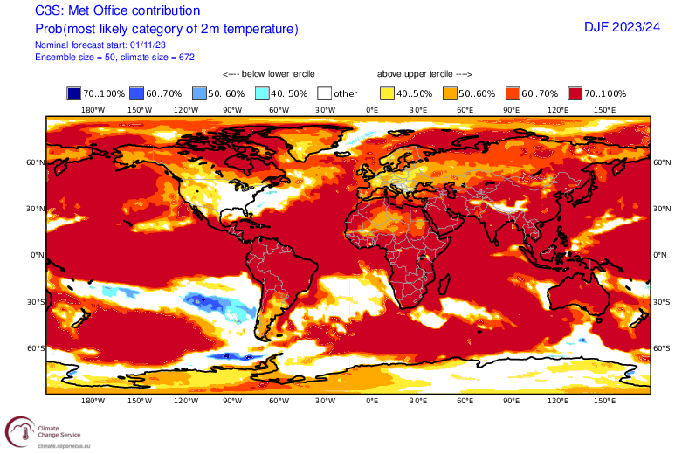
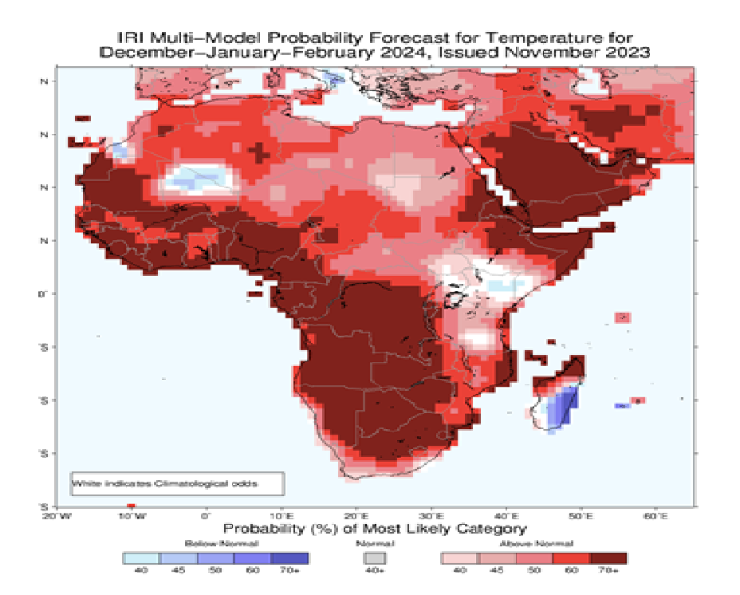
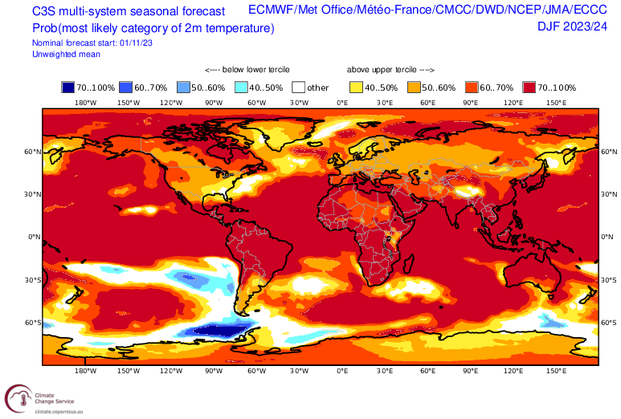
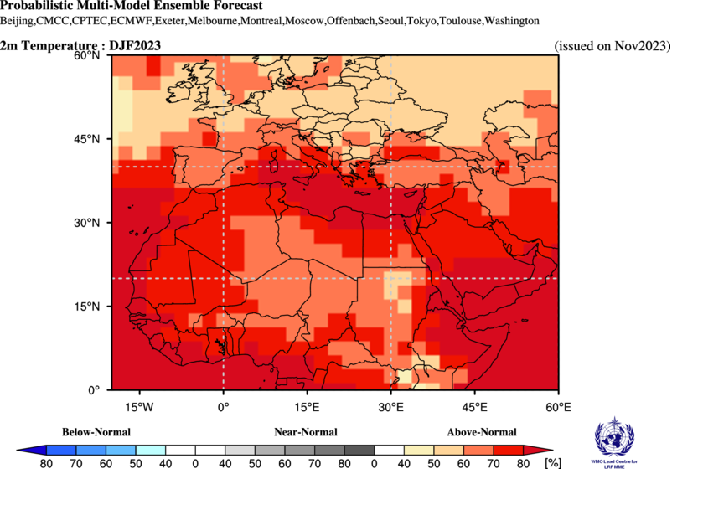
ECMWF
Met-Office
IRI
C3S
WMO-LRF MME

Slide 13
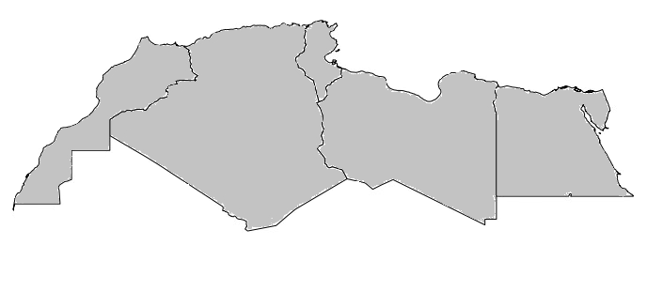
Summary from NA RCC-LRF
Precipitation
B/N/A
B : Below normal
N: Near normal
A: Above normal
33/33/33
For Precipiation : No special scenario is favoured over North Africa

Slide 14
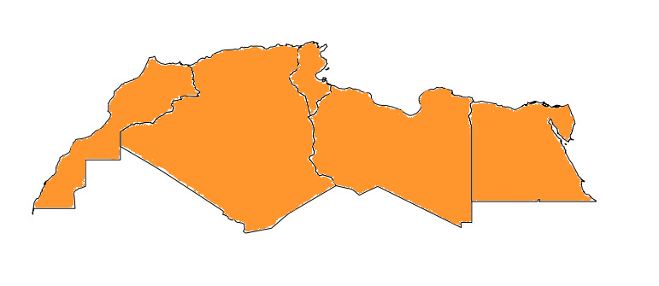
Summary from NA RCC-LRF
Temperature
B/N/A
B : Below normal
N: Near normal
A: Above normal
25/25/50
For temperature: A warmer than average temeparture over North Africa

Slide 15
Thank you very much

