Slide 1





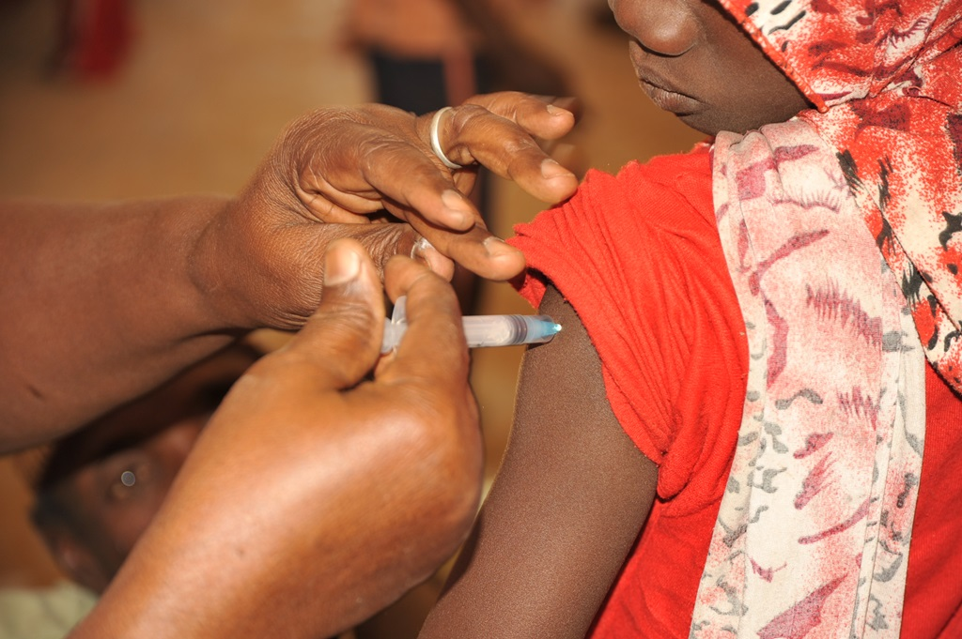
Climate & Health Desk
Improving Meningitis Early Warning System
Building Cross-Sectoral Bridges Between Climate Science and Public Health

Slide 2
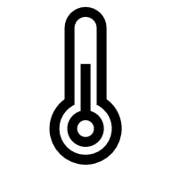



What is Climate & Health Desk
Health Systems Under Pressure
Climate change is not just an environmental issue; it is a fundamental threat to human health
We need to ACT NOW
Amplifying Health Risks
Climate change is intensifying heatwaves, flooding, vector-borne diseases, and deteriorating air quality, directly impacting vulnerable populations.
Data & tailored Climate Services Gap
Health systems often lack timely, localized, and tailored climate and weather intelligence required for effective operational decision-making
Coordination
Persistent gaps exist in cross-sector coordination between meteorological agencies and health ministries
Policy
Institutional Capacity
There is a critical need to institutionalize co-produced, demand-driven services to support long-term

Slide 3


What is Climate & Health Desk
BRIDGING SCIENCE & ACTION
Climate- health desk will act as a continental hub for climate-health action, serving three distinct bridging functions to transform raw data into lifesaving decisions.
Meteorological
Community
Science & Forecasts
Technical Bridge
Translating complex meteorological data into accessible health risk indicators
Operational Bridge
Delivering co-designed services integrated into existing health workflows. Ensuring information arrives at the right time, in the right format, for the right users.
Collaborative Bridge
Formalizing data sharing, joint planning, and service integration. creating a sustained dialogue between both sectors.
Climate-Health Desk The Critical Interface
Health Community

Slide 4
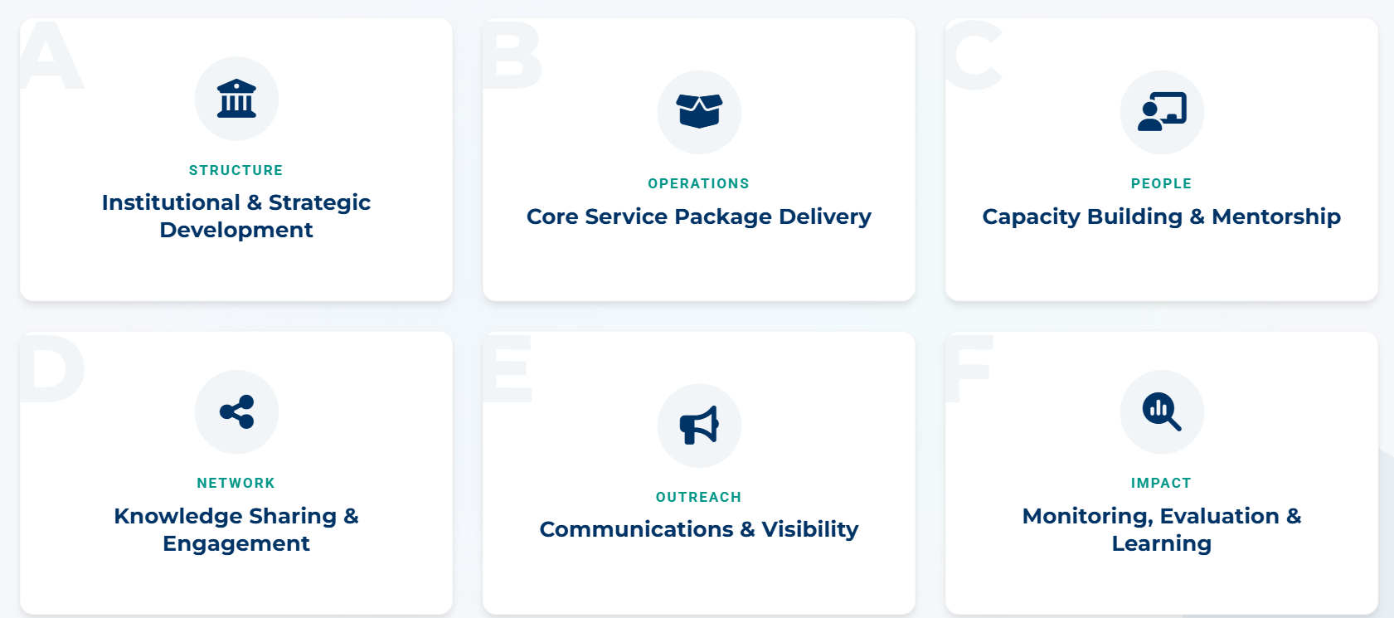
Objectives of Climate & Health Desk

Slide 5
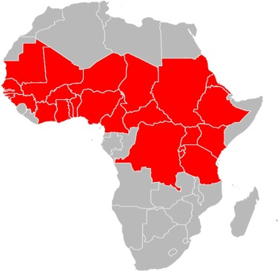
Meningitis Overview
Meningitis Belt
The African “Meningitis Belt” is a region in sub-Saharan Africa where the incidence of meningitis is significantly higher than elsewhere in the world.
Stretches across 26 countries.
Home to over 450 million people.
Outbreaks are closely linked to dry-season environmental conditions high temperatures, low humidity, and elevated dust concentrations
Meningitis Belt

Slide 6
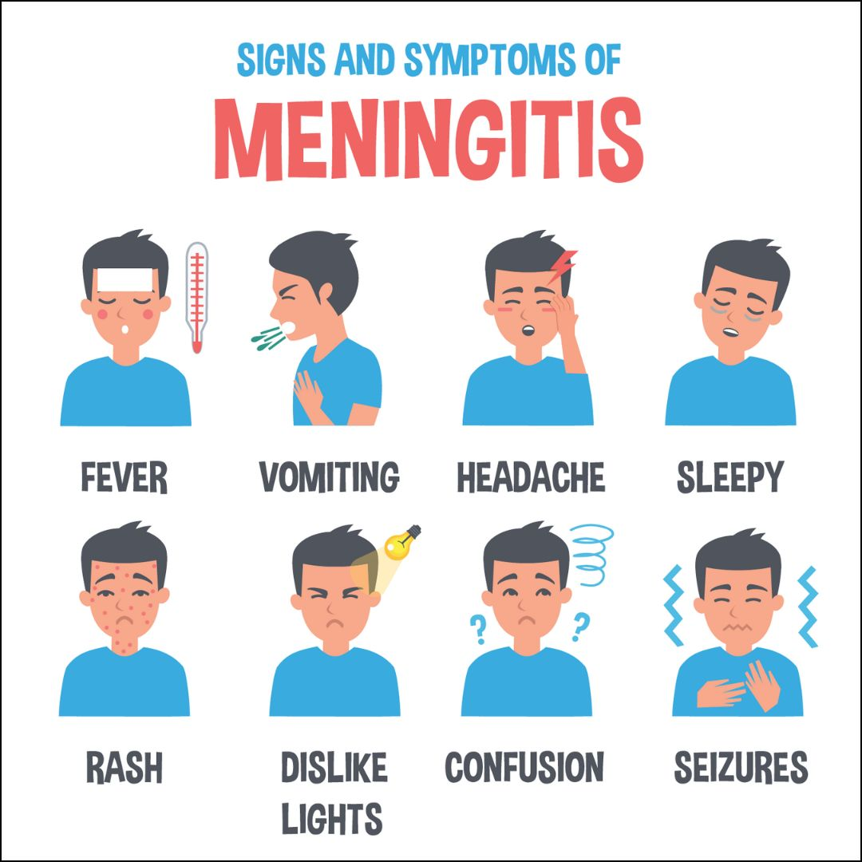
Meningitis Overview
Meningitis is the inflammation of the protective membranes (meninges) that cover the brain and spinal cord.
Person-to-Person Transmission
Meningitis common pathogens: Bacterial, Viral, Fungal
Meningitis pathogens are often spread through respiratory droplets and oral secretions.
Dust particles in dry atmosphere do act as a physical irritant to the respiratory tract.

Slide 7
Meningitis Overview
Widespread Impact
Despite significant progress in vaccination, thousands of cases continue to be reported annually across the meningitis belt.
Outbreaks can occur rapidly, overwhelming local healthcare systems and requiring emergency international response measures.
30,000
Estimated Annual Cases
Approximately 10% resulting in death

Slide 8
Meningitis Vigilance Thresholds
Data: GEEFS/ECMWF S2S (Temperature and humidity)
, Copernicus Atmosphere Monitoring Service (Dust) , ERA5 for bias correction (observations)
 | Phenomenon | Hazard | Potentials Impacts | Advisory / Measures
 | Dust concentration below 150μg/m³ Relative humidity above 40% Temperature below 27ºC | Emergence of Meningitis cases not likely | Potential pressure on the health system | Routine surveillance systems at regional and national levels
 | Dust concentration between 150 to 400μg/m3 Relative humidity between 20 & 40% Temperature above 27ºC | Emergence of Meningitis cases very likely | Loss of life, pressure on the health system | Activation of surveillance systems at regional and national levels
 | Dust Concentration at least 400μg/m3 and above Relative humidity less than 20% Temperature above 30ºC | Emergence of Meningitis cases very likely and epidemic status possible | Loss of life, increased pressure on the health system | Strengthen and increase meningitis surveillance systems at both regional and national levels

Slide 9
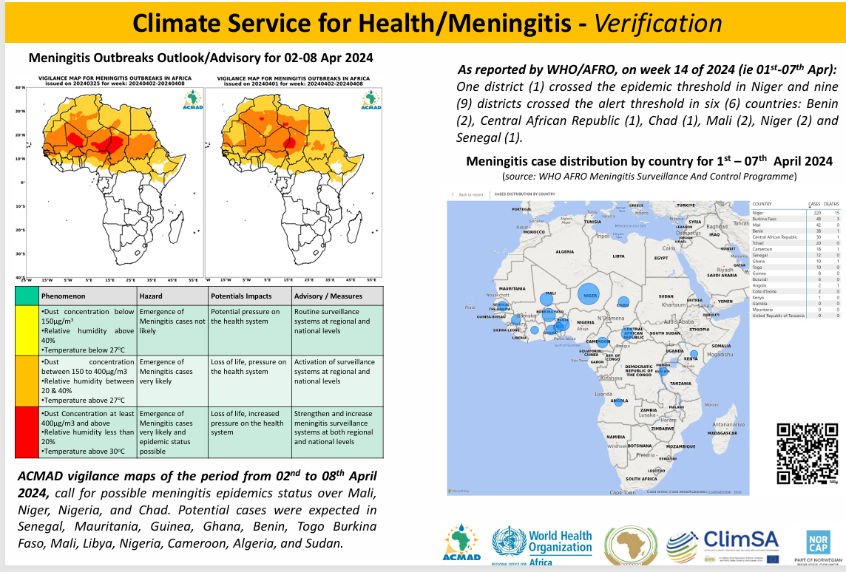
MENINGITS EWS

Slide 10
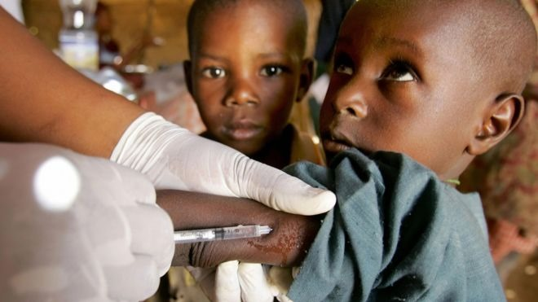
MENINGITIS EWS
ACMAD
Generate & present Meningitis vigilance maps for Week 1& Week 2
WHO-AFRO
Coordinates the meningitis bi-monthly Meeting, updates the preparedness action plan
IMPACT
Improved surveillance & preparedness, Cross sectorial capacity built, data shared, Meningitis EWS improved
COUNTRY HEALTH SERVICES and other stakeholders (ACDC,MSF ..) provide the current status, cases & action plan

Slide 11
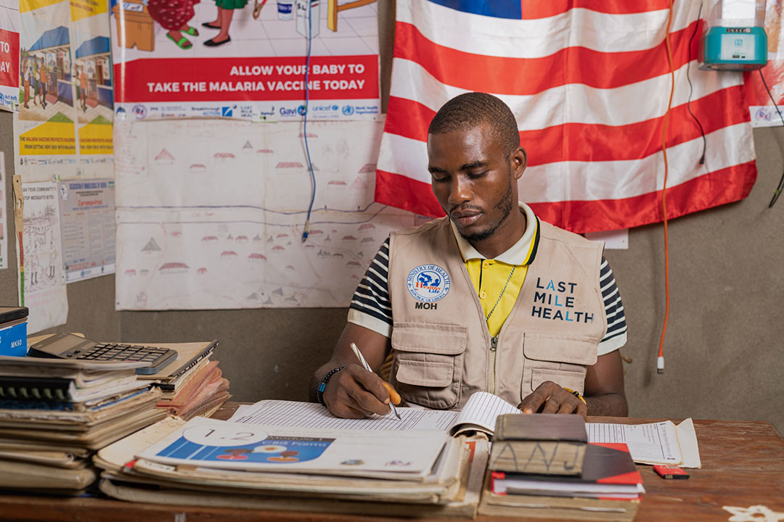
2021 Impact Case
Success in Niger & Ghana
In 2021, the growth of meningitis epidemics in western Niger and northern Ghana was rapidly halted.
The success was attributed to the integrated preparedness framework, allowing for mass vaccination within tight windows of opportunity created by climate-informed surveillance.
Source: www.gavi.org

Slide 12

Lessons Learnt & WAY FORWARD
  Proactive collaboration with WHO/AFRO and ClimHealth Network has proven very useful in the uptake of climate information for public health preparedness
  Regular feedback of information help improve the quality of Climate Service
  Next Steps: Improving the Meningitis forecasting model by integrating ECMWF ens Model

Slide 13
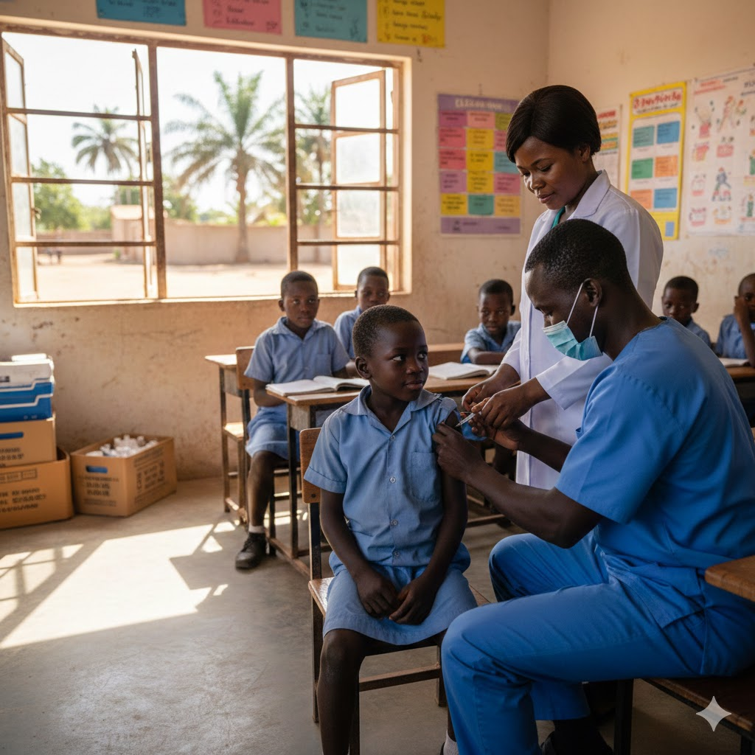










THANK YOU
MERCI
OBRIGADO
Notes:
13

