Slide 1


Science | Policy |Practice
Innovation
Ferdousa Ibrahim
Technical Advisor, Health and Climate

Slide 2
AGENDA
Climate Centre – Who we are
Health Team’s range of work
Anticipatory Action (AA)
AA for Epidemics
Meningitis early warning system feasibility study

Slide 3
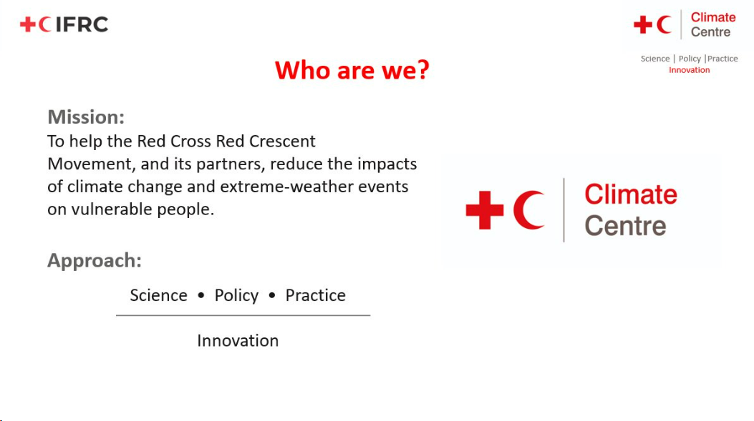
Who we are
Mission
Support the Red Cross and Red Crescent Movement and its partners in reducing the impacts of climate change and extreme weather events on vulnerable people.
Approach
Science
Policy
Practice
Innovation
Notes:
The Climate Center is a Global reference center of the International Federation of Red Cross and Red Crescent Societies (IFRC) with a mission to support the Red Cross Movement and its partners in reducing the impacts of climate change and extreme-weather events on vulnerable people.
The Climate Centre operates at the intersection of science, policy, practice and innovation with a core objective of making scientific insights actionable at the local level and translating climate research into practical tools and guidance for National Societies and partners across the Movement as well as outside the movement.

Slide 4

Climate Centre -Health Team Work
Analyzing heat impacts on health
Epidemiological Modelling
Climate-Health Vulnerability and Risk Assessments
Developing tools for monitoring climate-environment health impacts
Anticipatory Action for Climate-Sensitive Infectious Diseases

Slide 5

Anticipatory Action
Red Cross Red Crescent Movement
Notes:
A major pillar of our work is anticipatory action where we make use of Weather and climate forecast data to anticipate hazards before they occur

Slide 6
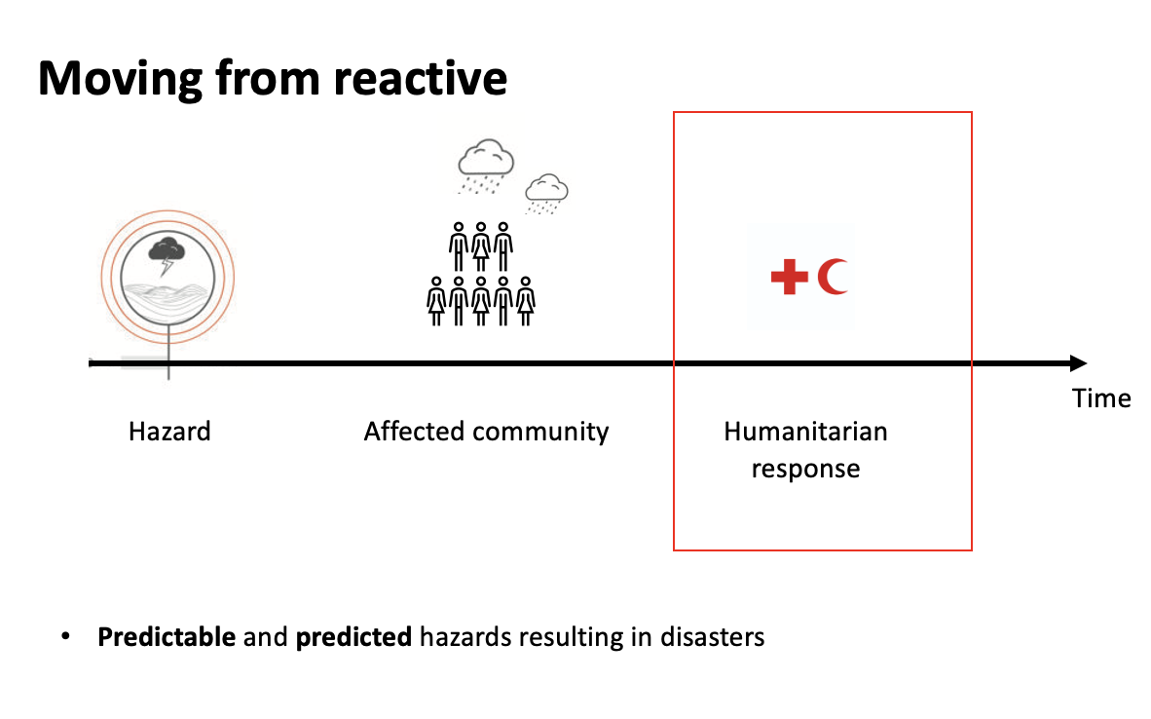
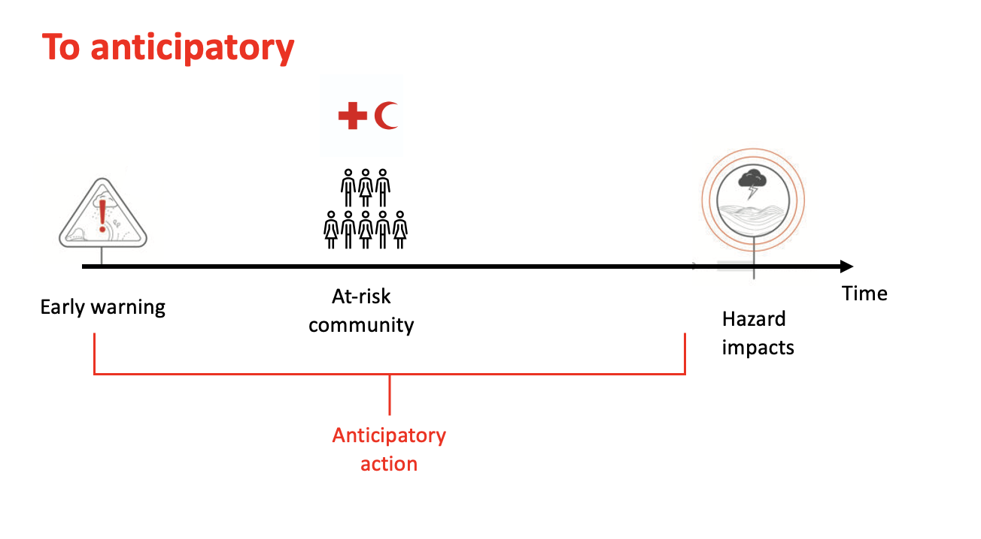
Notes:
Historically, humanitarian action has typically been reactive. The humanitarian system kicks into action when a hazard affects a community escalating needs and requiring a humanitarian response. However, as weather and climate forecasting technology improved it became clear that many of the hazards leading to disasters were in fact predictable or had indeed been predicted.
This realisation led to a greater focus on how we could harness the use of early warnings to act before the hazard occurs or before the major impacts of the hazard are felt, Which is what anticipatory action is all about …and is a hallmark of the work we do in Designing anticipatory action programmes, including FbF, technical stupport, research on all aspects of AA and monitoring and evaluation of these programs
.

Slide 7
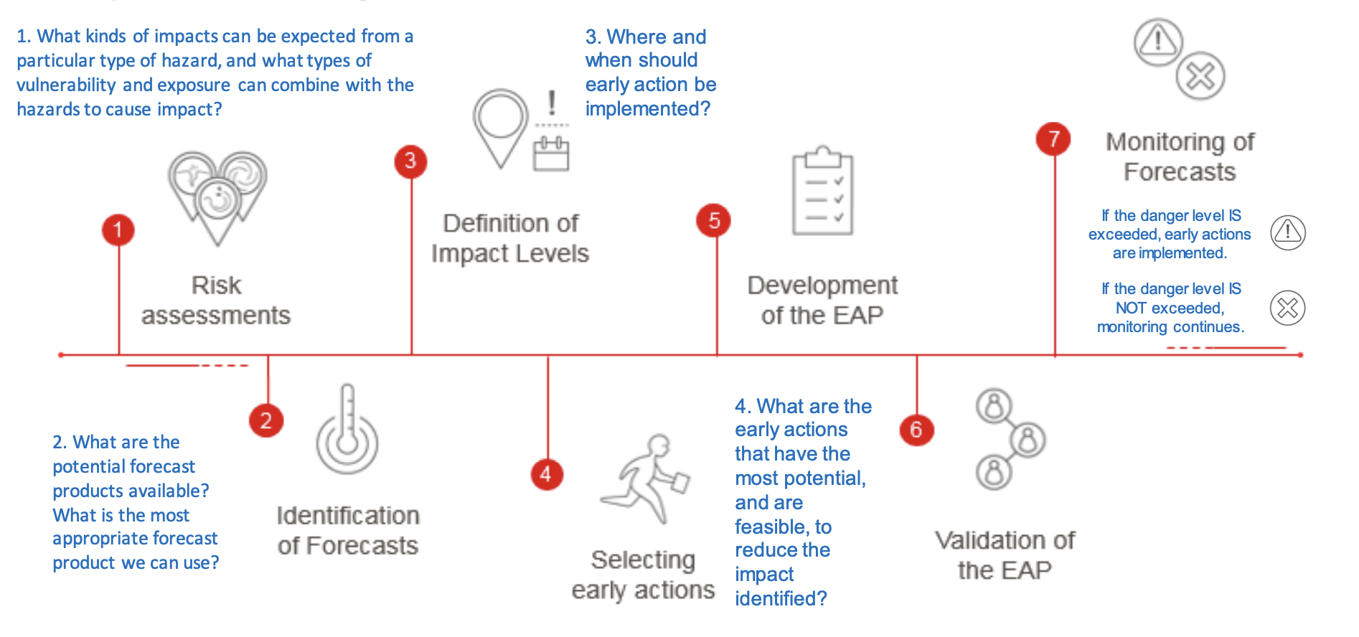
Institutionalising the use of early warnings:
Anticipatory Action
At-risk community
Notes:
The process of developing an anticipatory action system involves several steps and often begins with a feasibility study which helps prioritise which hazard to focus on.
This comprises of an assessment of the risks (what are the key hazards, vulnerabilities and exposures and likely impacts?) and what are the potential forecast products available?
Once the hazard and forecasts have been selected there is a focus on where is most likely to be impacted and what are the early actions that have the most potential and are feasible for the implementing agency to reduce the identified impact
this is usually formalised into a written protocol, which in the Red cross movement is called an Early Action Protocol or EAP. The EAP is validated by a committee and then is live and NS should monitor the forecasts in case an early warning is issued…once an early warning is activated based on the trigger threshold being reached, the EAP is in full effect, the early actions developed in the protocol are carried out.

Slide 8
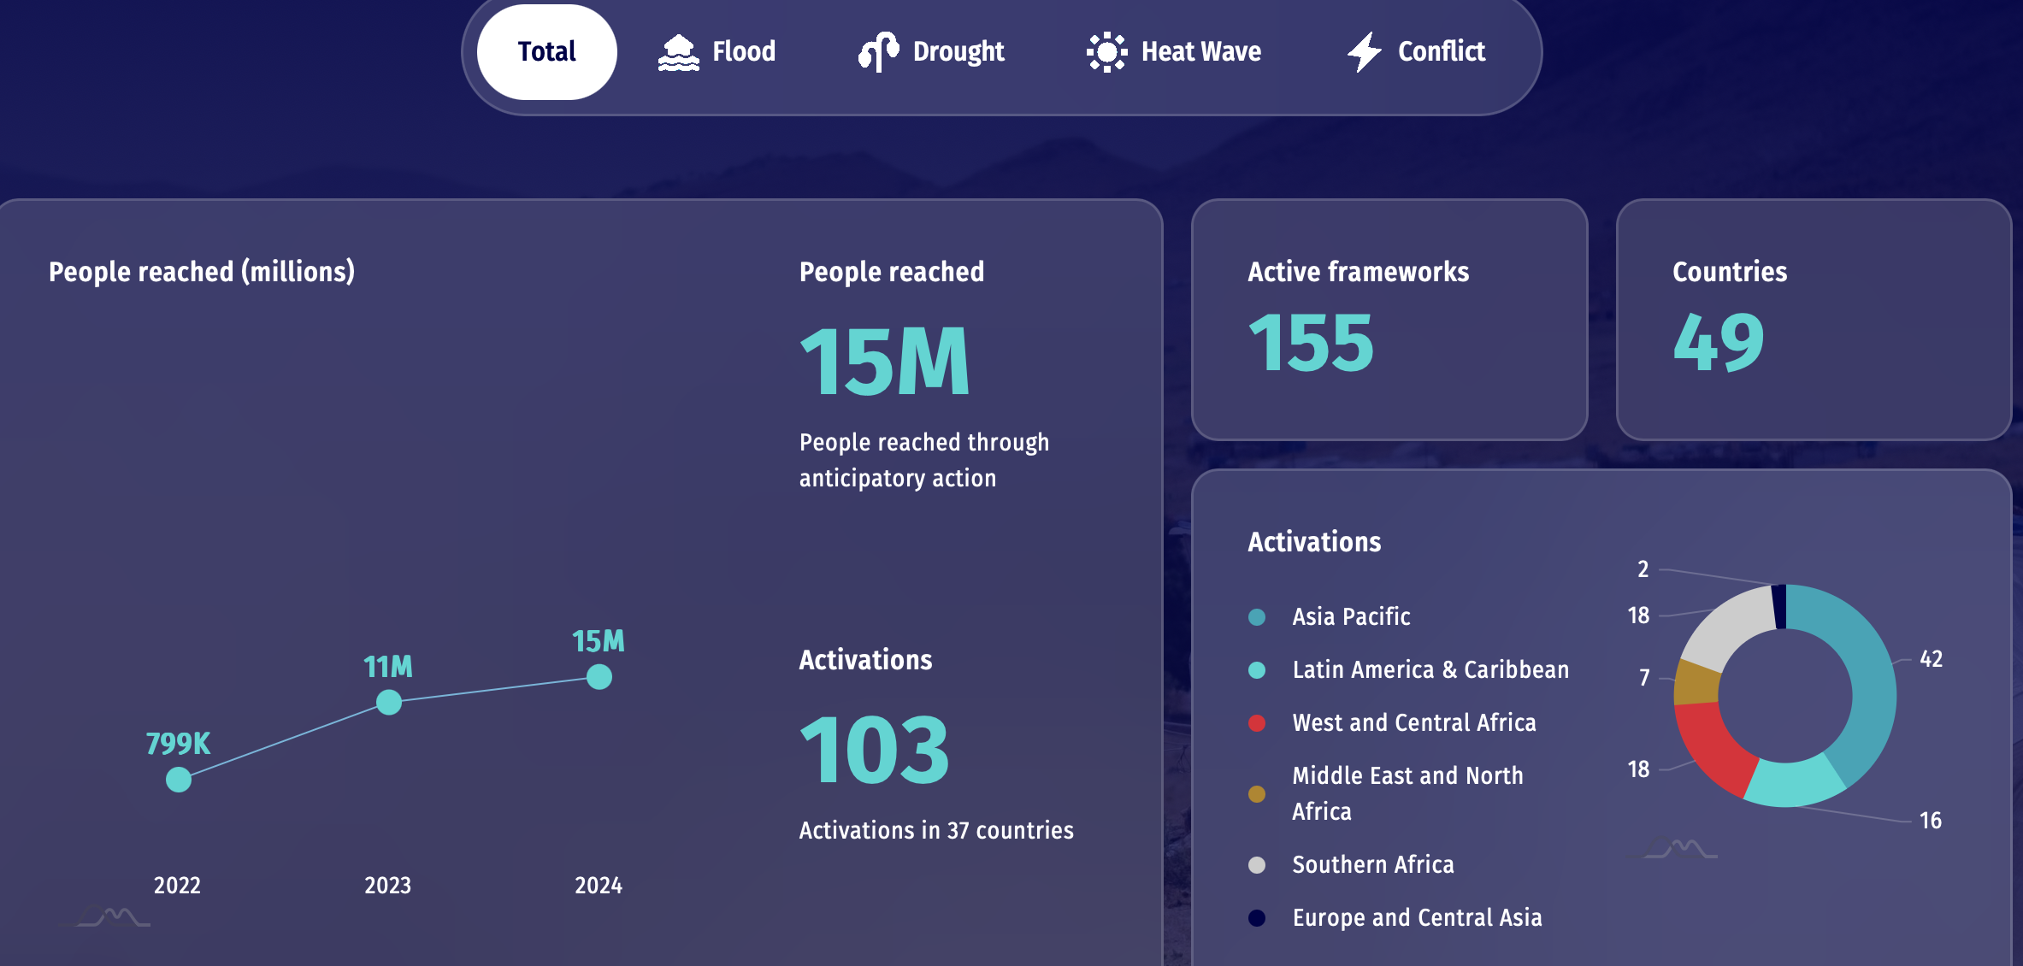
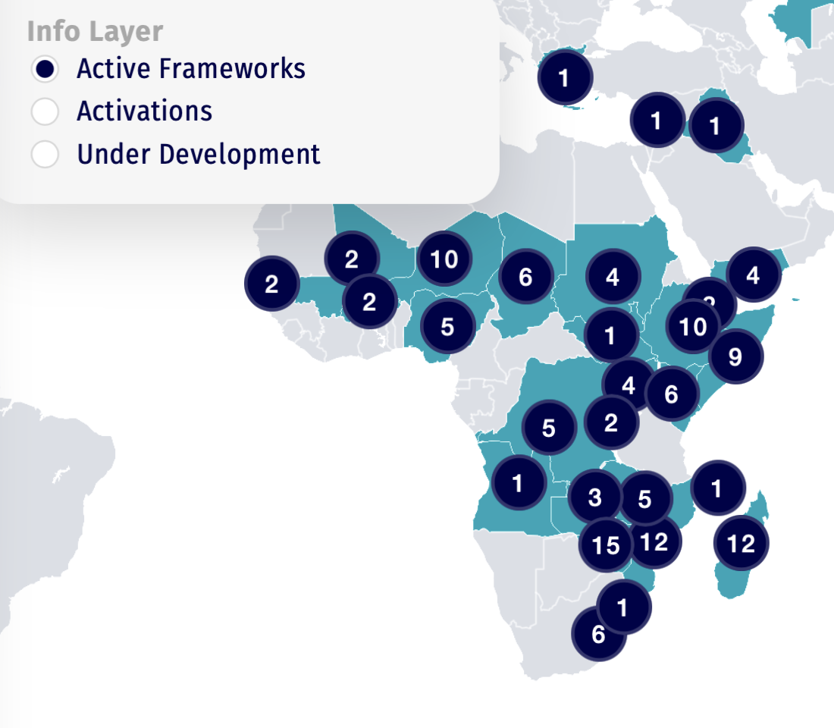
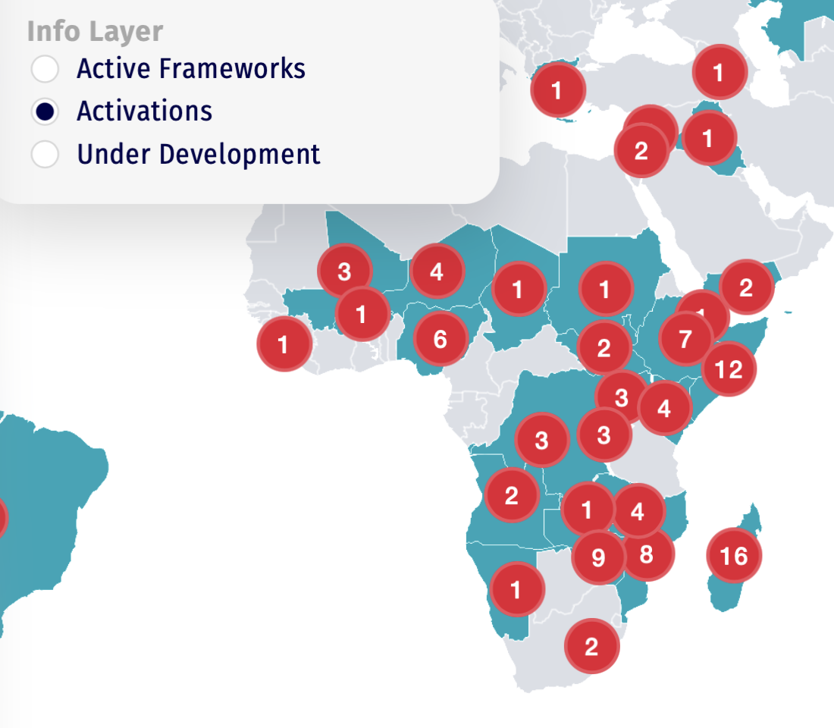
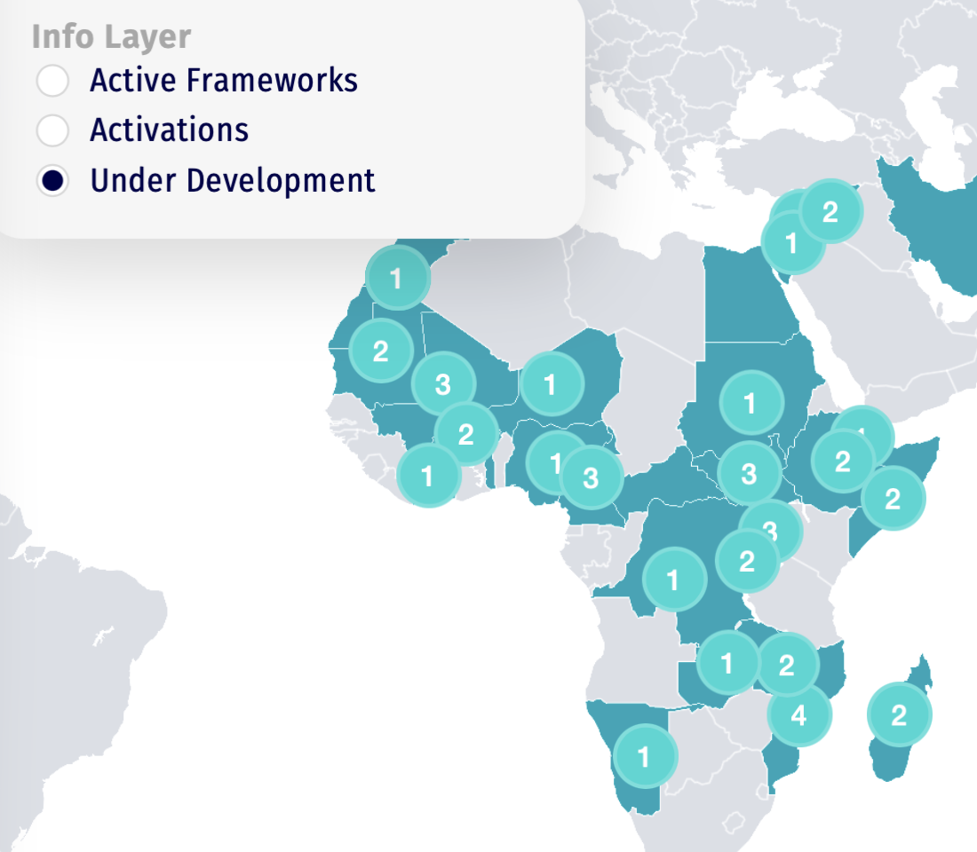
Anticipatory Action in 2024 in numbers
==> Positive trend in people being protected with AA
==> Flood, drought and Heatwave hazards are mainly targeted in the Sahel
==> Activation is still a challenge in Africa: Coordination and triggering mechanisms
==> Some health-related framework under development
Notes:
This particular slide is just showing what anticipatory action actually looked like in numbers in 2024…across the Movement, anticipatory action reached around 15 million people last year, up from well under a million just a few years ago, protecting more vulnerable populations
floods, droughts and heatwaves are still the main focus, especially in the Sahel and wider African region. There are many active frameworks across Africa, but activation remains a key challenge in Africa.because actually triggering them requires strong coordination between met services, disaster management, and increasingly the health sector, as well as trigger mechanisms that are realistic and understood by all partners
We are trying to develop more health‑related AA frameworks by integrating health outcomes, climate‑sensitive diseases and heat impacts, which is exactly where the Climate Centre health team is focusing its support at the moment

Slide 9
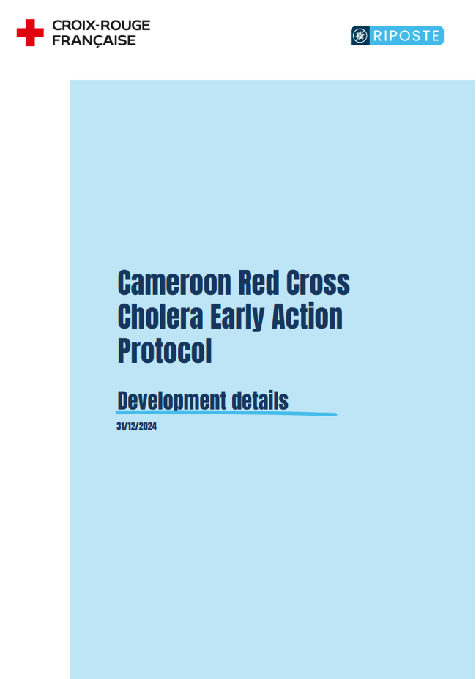
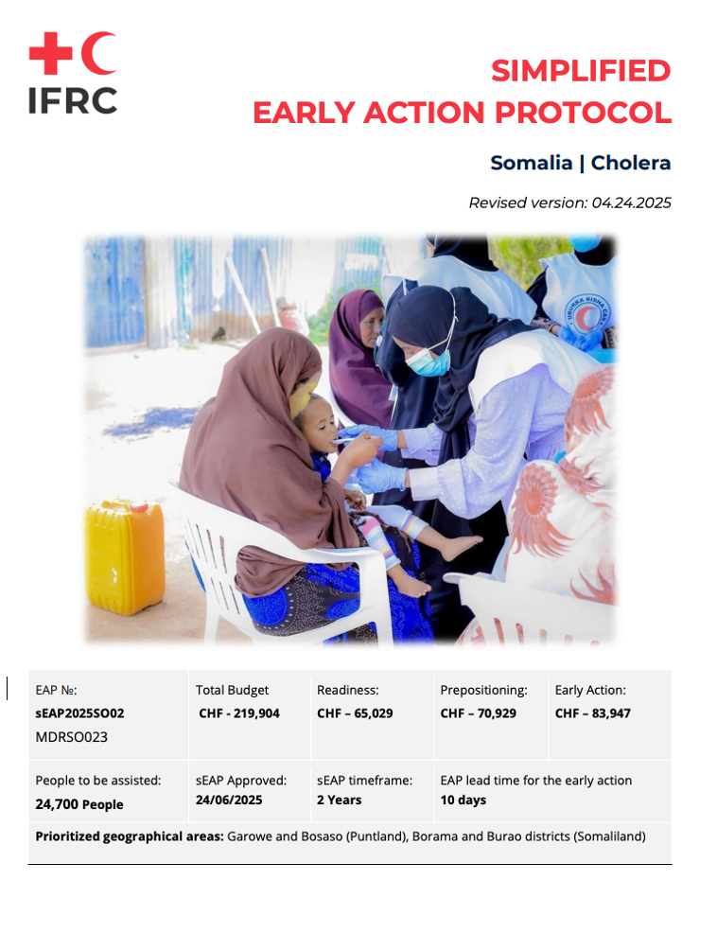
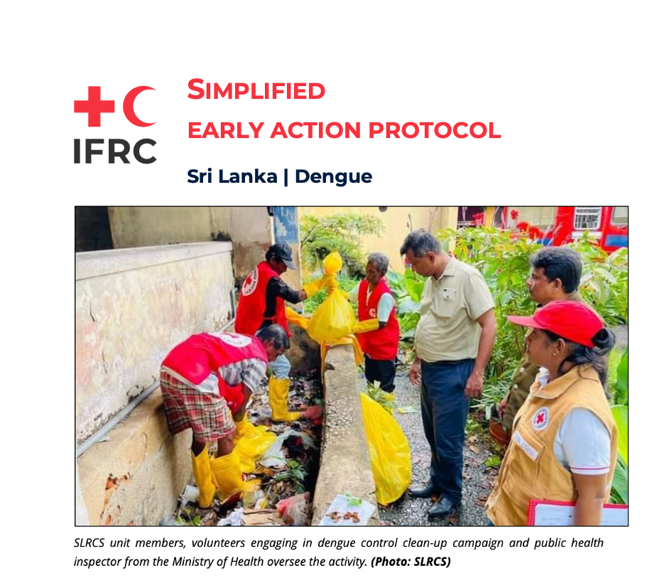
Anticipatory Action for Epidemics
Red Cross Red Crescent Movement
Notes:
Some of the work we’ve developed for anticipatory action for epidemics relates to eap for cholera in somaia, dengue in sri lanka, cholera in Cameroon and several others..

Slide 10
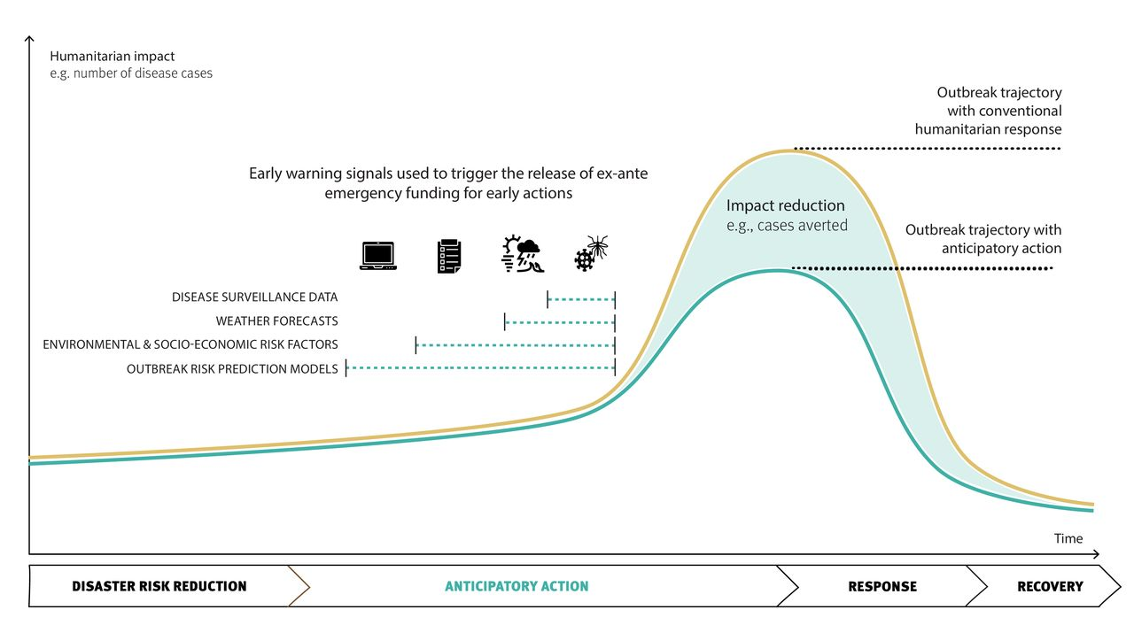
Trigger Guidance
Alcayna et al (2025) BMJ Global Health
Notes:
We provide a lot of guidance and analysis on trigger development and we have 4 approaches for selecting the appropriate trigger mechanism.
Triggers based on epidemiological information (i.e. numbers of cases of a disease)
Triggers based on extreme weather events floods, droughts, tropical cyclones.
Triggers based on risk factors ,for some hazards, including disease transmission, it makes more sense to have phased triggers which activate different actions as we become more certain about the risk levels.
For example, for cholera, you may have a first trigger related to risk factors (such as flooding or population displacement) which triggers actions in a large intervention area, using limited resources for low or no-regrets actions such as health promotion activities.
A second trigger might be related to epidemiological trigger (confirmed cholera case) which activates actions in specific affected communities to break transmission.
Triggers based on disease model
Each has different trade-offs in terms of the lead time available to act and the certainty of an impending outbreak

Slide 11

Meningitis EWS Feasibility study
National Societies of West Africa:
Burkina Faso
Ivory Coast
Senegal
Mauritania
The Gambia
Ghana
Mali
Notes:
conduct a Feasibility Study to understand which RCRC National Societies in West Africa are currently involved in meningitis preparedness and response and how we can support the integration of anticipatory action for meningitis in their programming

Slide 12
Objectives of FS
Early warning capacity
Surveillance systems
Institutional workflows
Identify gaps and opportunities
Roadmap for integrating CI into Meningitis anticipatory action
Notes:
More specifically, assessing the current early‑warning capacity, so understanding how well they are able to detect, monitor, interpret, and act on early signs of health threats, such as meningitis outbreaks — especially using climate and epidemiological information.. map surveillance sysstems, how accessible epidemiological outbreak information is available , and whether they are timely and reliable enough for anticipatory action, we are also analyzing institutional workflows and how it is implemented in practice at national level, Building on that, we are aiming to identify gaps and opportunities for finally producing a roadmap for potentially integrating climate information into national meningitis preparedness plans and anticipatory action systems.

Slide 13
THANK YOU

