Slide 1




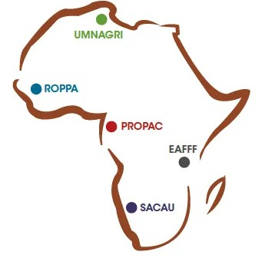


User Information Platform (UIP)
Needs in Climate
Information Services
Presented by
Project Launch
WISER-PASS Project Kick-off Meeting
SCHADRACK SENEZA
M&E OFFICER
Date
Location
Thursday, February 26, 2026
Lomé, Togo
© 2026 Pan African Farmers' Organization

Slide 2









About PAFO
WISER-PASS PROJECT
Pan-African Farmers’ Organization
Our Identity
The Pan-African Farmers’ Organization (PAFO) is the highest representative body of African farmers at the continental level. It serves as a unified voice for millions of smallholder farmers, pastoralists and fisherfolk, facilitating dialogue with continental and international institutions.
80M+
80
African Farmers
National Orgs
50
5
Countries
Regional Networks
Our Mission
A vibrant, prosperous and sustainable African agriculture that ensures food security and sovereignty, including socio-economic and cultural development.
Founding & Status
Founded
October 2010, Lilongwe, Malawi
Sponsored by the African Union
Core Functions & Objectives
Headquarters
Kigali, Rwanda
Advocacy: Representing farmers' interests in continental and global forums.
Reg: 001/RGB/19 (Int'l NGO)
Partnership Facilitation: Bridging gaps between farmers, technical partners, and financial institutions.
Capacity Development: Strengthening member networks to better serve their constituents.
"Operating at the heart of African agriculture"
Knowledge Management: Disseminating critical information, including climate services.

Slide 3








Membership Base
WISER-PASS PROJECT
Regional Networks & Coverage
Regional Farmer Networks
Continental Coverage
PAFO coordinates five autonomous regional networks, each representing national farmer organizations in their respective geographic zones.
NORTH
UMNAGRI
Maghreb
Maghrebian and North African Union of Farmers
EAST
EAFF
UMNAGRI (North)
Eastern African Farmers Federation
East Africa
ROPPA (West)
PROPAC (Central)
EAFF (East)
WEST
ROPPA
SACAU (South)
West Africa
Network of Farmers' Organizations & Agricultural Producers of West Africa
CENTRAL
PROPAC
Central Africa
Organizational Reach
5
50
80
Regional Platform of Farmers' Organizations of Central Africa
Regional
Networks
Member
Countries
National
Organizations
SOUTH
SACAU
Southern Africa
Southern African Confederation of Agricultural Unions

Slide 4


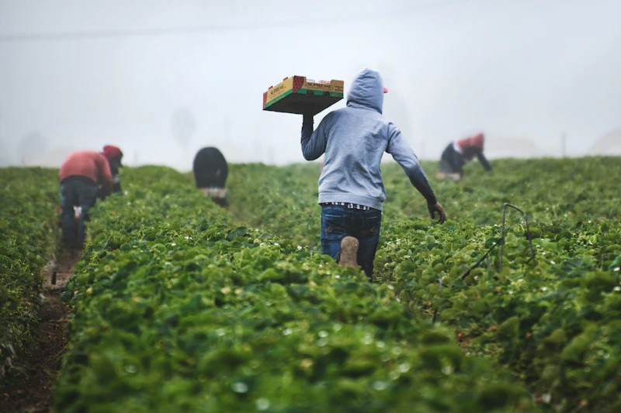









Primary End-Users
WISER-PASS PROJECT
Climate Information Services Target Groups
User Context
Key constraints affecting service delivery
Smallholder Farmers
70% of Africa's Farmers
Limited Literacy
Requiring visual or voice-based formats rather than complex text bulletins.
Managing 1-5 hectares, predominantly rainfed agriculture. They make critical planting decisions with limited resources and are most vulnerable to climate variability.
Poor Connectivity
Rural areas suffer from limited internet access, affecting digital delivery channels.
Language Diversity
Pastoralists
Extension Workers
Multiple local languages necessitate translation beyond official national languages.
Heavily dependent on seasonal forecasts for grazing lands and water availability. Movement patterns are dictated by climate conditions.
Crucial intermediaries who translate technical meteorological information into actionable advice for farmers on the ground.
Time Sensitivity
Critical planting and harvesting decisions require timely information.
Cooperatives
Agribusinesses
High Vulnerability
Agricultural organizations making collective decisions on input procurement, credit access, and marketing strategies based on seasonal outlooks.
Direct exposure to climate shocks and extreme weather events.
Private sector entities planning supply chains, logistics, storage, and market operations that are sensitive to production volumes.

Slide 5












Current Gaps
WISER-PASS PROJECT
Challenges in the User Information Platform
Timing Disconnect
Seasonal forecasts often arrive after planting decisions have been made and inputs purchased, rendering the information actionable only for the next season rather than the current one.
Critical
Disconnects
Scale Mismatch
Regional forecasts cover vast areas, lacking specific, downscaled details needed for local farm management. Regional averages often mask local micro-climate variations essential for decision making.
Despite availability of meteorological data, significant barriers prevent this information from creating value for African farmers.
Language & Format Barrier
Bulletins use technical meteorological terms (e.g., "terciles", "probabilities") rather than actionable agricultural advisories. Farmers need to know "what to plant," not just "probability of rain."
Key Impact
Reduced agricultural productivity and increased vulnerability to climate shocks.
The Last Mile Gap
Information frequently fails to reach remote and vulnerable communities due to poor dissemination infrastructure, reliance on internet-based channels, and lack of integration with trusted local networks.

Slide 6




Core Requirements
WISER-PASS PROJECT
For Effective Climate Information Service
User-Centric Approach
Meeting farmers where they are with information they can use.
Locally Specific
Actionable Advice
Timely Delivery
Translated into clear agricultural advisories (e.g., Plant drought-resistant varieties, "Prepare for early onset").
Downscaled to district or village level. Regional averages are not useful for local planting decisions.
Received 2-4 weeks before season onset to influence seed selection, land preparation, and procurement.
Accessible Channels
Multi-Hazard Integration
Delivered through channels that reach the last mile: radio, SMS, extension services, farmer field schools.
Integrating warnings for related risks such as pests (locusts), crop diseases, floods, and dry spells.

Slide 7





















Technical Variables
WISER-PASS PROJECT
Specific Data Points Users Need
Key Climate Variables
Beyond Meteorology
Impact-Based Info
Onset Dates
Pest & Disease Risk
When exactly will rains start? Critical for sowing timing and avoiding "false starts" that waste seeds.
Advisories on conditions favorable for locusts, fall armyworm, or fungal diseases.
Intra-seasonal Distribution
Predictions of dry spells (10+ consecutive days without rain) during the growing season.
Water Availability
Forecasts for soil moisture levels and water availability for irrigation or livestock.
Cessation Dates
When will rains end? Essential for selecting appropriate crop maturity varieties (short vs long cycle).
Market Implications
Rainfall Intensity
Economic outlooks based on expected harvest volumes and regional climate patterns.
Warnings for extreme heavy rainfall events that cause flooding, soil erosion, or crop damage.
Temperature Extremes
Heat waves or cold snaps that affect sensitive crop development stages.

Slide 8




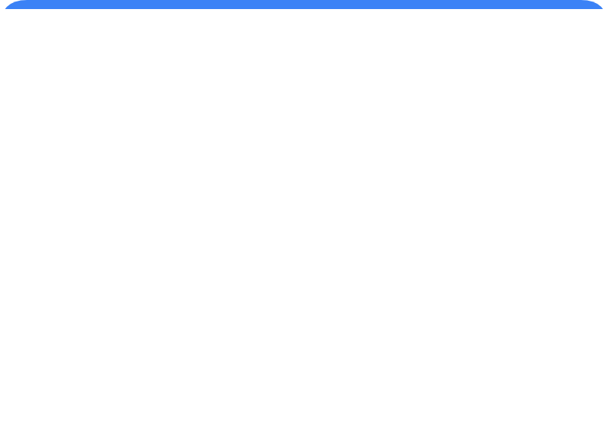











UIP Design
WISER-PASS PROJECT
Delivery Channels & Formats
Preferred Delivery Channels
Format Requirements
Usability & Comprehension
Community Radio
Simple & Visual
Multilingual
Most effective tool for mass reach in local languages across rural Africa.
Voice messages and text in local dialects for better comprehension.
Pictograms and clear visuals instead of text-heavy PDF bulletins.
Mobile Technology (SMS/USSD)
Rapid alerts and simple text-based or audio advisories direct to users.
Color-Coded
Localized Maps
Agricultural Extension Services
Human intermediaries essential to interpret data and contextualize advice.
"Traffic Light" system (Red/Amber/Green) for intuitive risk levels.
Downscaled visual maps relevant to specific districts or villages.
Farmer Field Schools
Peer-to-peer learning environments for discussing seasonal outlooks.

Slide 9



Expected Benefits
WISER-PASS PROJECT
Value of an Effective UIP
Farm-Level Benefits
Broader Impacts
Operational Gains
Optimized Planting Decisions
Reduction in false starts where farmers plant too early and lose seeds and inputs due to erratic rainfall onset.
Enhanced Food Security
Higher yields and reduced post-harvest losses at national scale leading to stable food supply.
Improved Input Management
Farmers can optimize fertilizer application timing to coincide with moisture availability and avoid losses from predicted heavy rains.
Economic Resilience
Better Crop Selection
Reduced financial losses, better market planning, and improved livelihoods for rural communities.
Choosing appropriate varieties (drought-resistant, early-maturing vs long-cycle) based on trusted seasonal outlooks.
Adaptive Capacity
Risk Mitigation
Communities better equipped to respond to climate variability and build long-term resilience to climate change.
Better preparation for dry spells through water harvesting, soil conservation techniques, or livelihood diversification.

Slide 10











Recommendations
WISER-PASS PROJECT
Strengthening the Platform
Strategic Goal
From Forecasts to Solutions
Transforming climate data into actionable resilience for African agriculture.
01
02
03
04
05
Institutionalize Co-Production
Invest in Intermediaries
Establish Feedback Mechanisms
Prioritize "Last Mile" Delivery
Develop Impact-Based Forecasts
Embed users (farmers, pastoralists) in NCOFs/RCOFs design and validation processes, moving beyond passive consumption.
Train agricultural extension agents, farmer leaders and CBOs to effectively interpret and communicate meteorological info.
Create clear two-way channels for users to report on forecast accuracy and utility, closing the learning loop.
Focus on low-tech, high-reach dissemination (radio, SMS, community meetings) for low-connectivity environments.
Move beyond meteorological parameters to sector-specific advisories for agriculture, health, water

Slide 11










Thank You
Together, let's transform climate information services to build a resilient future for African agriculture.
PAN AFRICAN FARMERS ORGANIZATION
Contact Us
KIGALI, RWANDA
admin@pafo-africa.org
February 2026
www.pafo-africa.org
Pan African Farmers' Organization (PAFO)
© 2026 All Rights Reserved

